Slide 1
CEIS150 Module 4
Creating a Chart
Professor: Dr. Omar Haddad
Student: . B. Lee Ecke

Slide 2
Rubric
Activity | Requirement(s) | Points
Chart | Screen shot of working Chart | 40
2

Slide 3
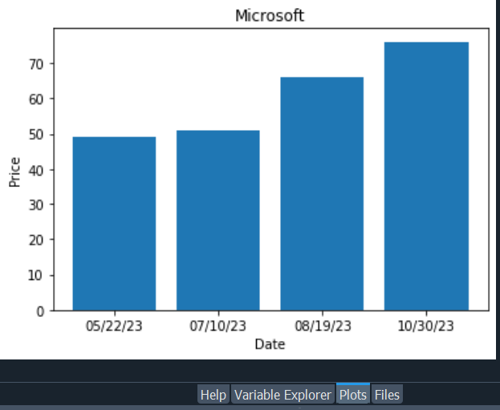
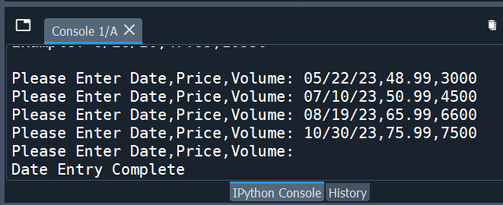
Bar Chart
3

